Slide 1

Parabola
RCET 0264 Introductory Calculus
Tim Leishman

Slide 2
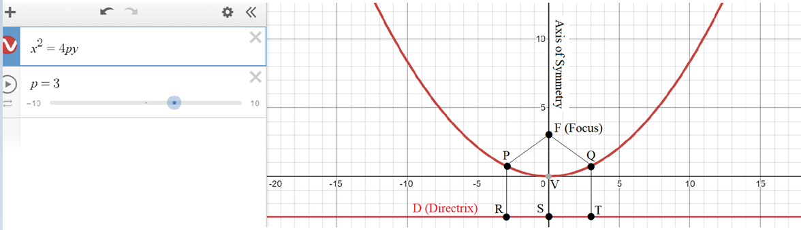
Parabola
Parabola consists of all points that are the same distance from a given fixed point and a given fixed line.
The fixed point is called the FOCUS
The fixed line is called the DIRECTRIX
The VERTEX is midway between the FOCUS and the DIRECTRIX

Slide 3
Parabola
Parabola consists of all points that are the same distance from a given fixed point and a given fixed line.
RP = PF
SV = VF
TQ = QF

Slide 4
Parabola
The fixed point is called the FOCUS

Slide 5
Parabola
The fixed line is called the DIRECTRIX

Slide 6
Parabola
The VERTEX is midway between the FOCUS and the DIRECTRIX

Slide 7
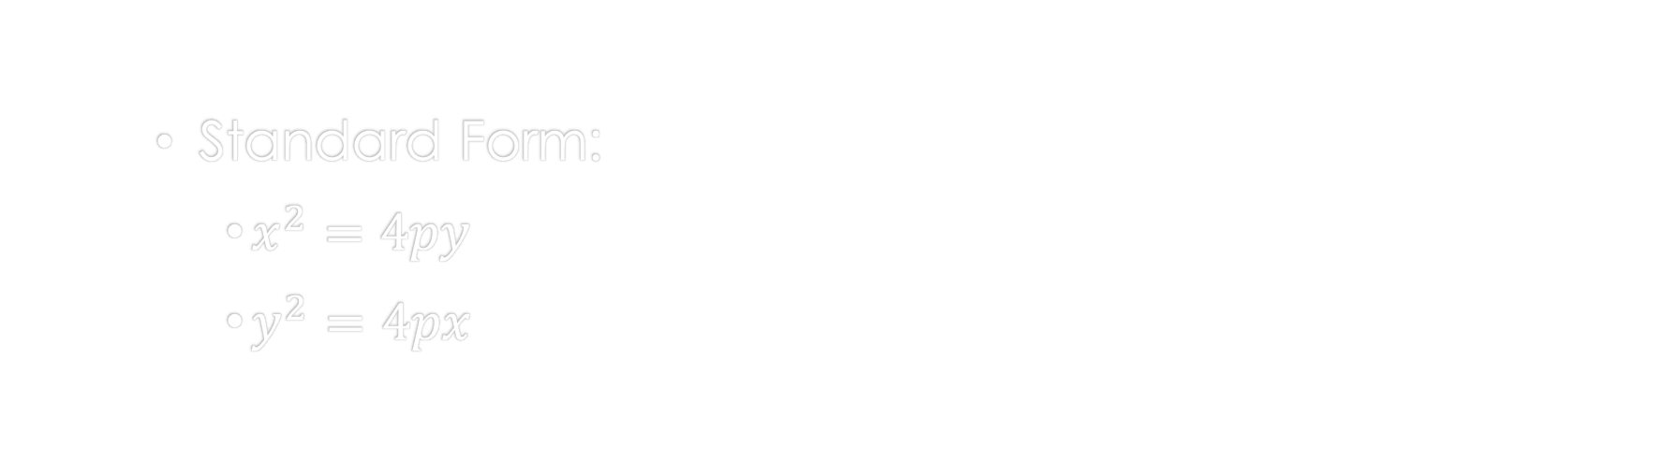
Parabola
Standard Form:
$x^{2}=4py$
$y^{2}=4px$

Slide 8
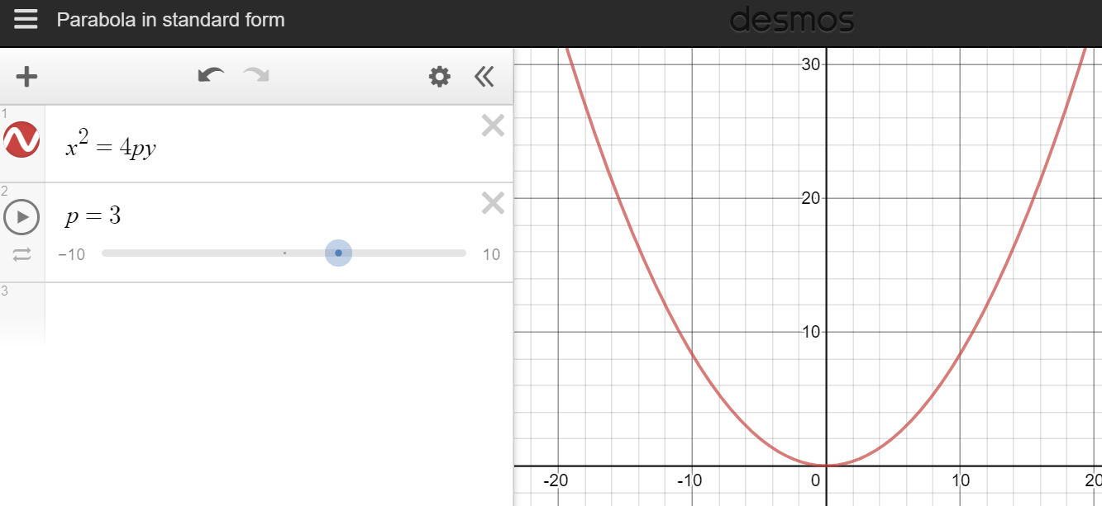
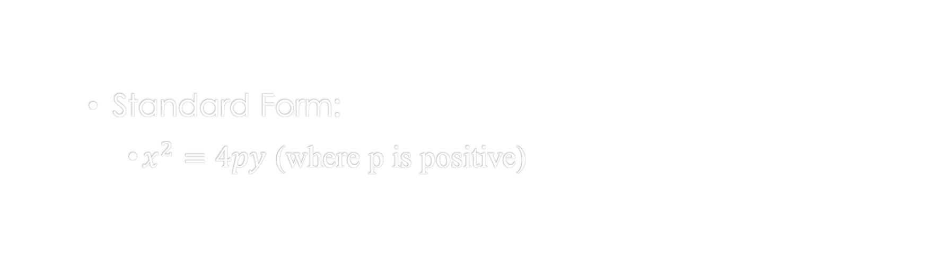
Parabola
Standard Form:
$x^{2}=4py$ (where p is positive)

Slide 9
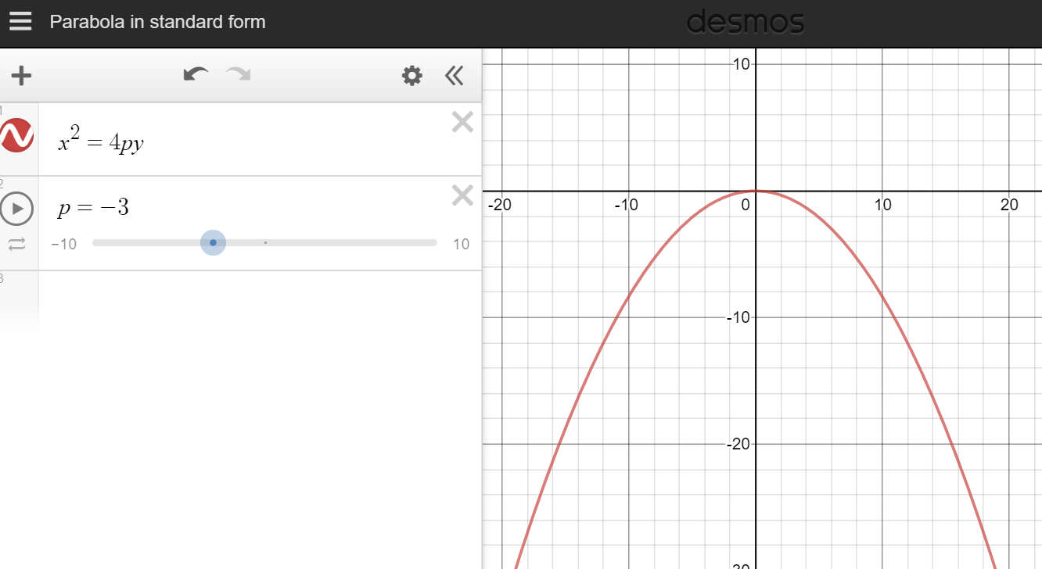
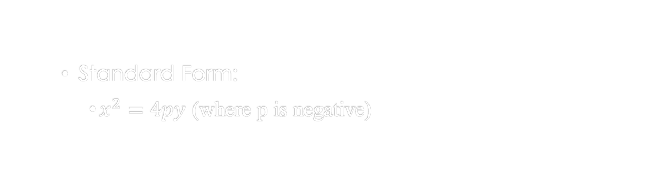
Parabola
Standard Form:
$x^{2}=4py$ (where p is negative)

Slide 10
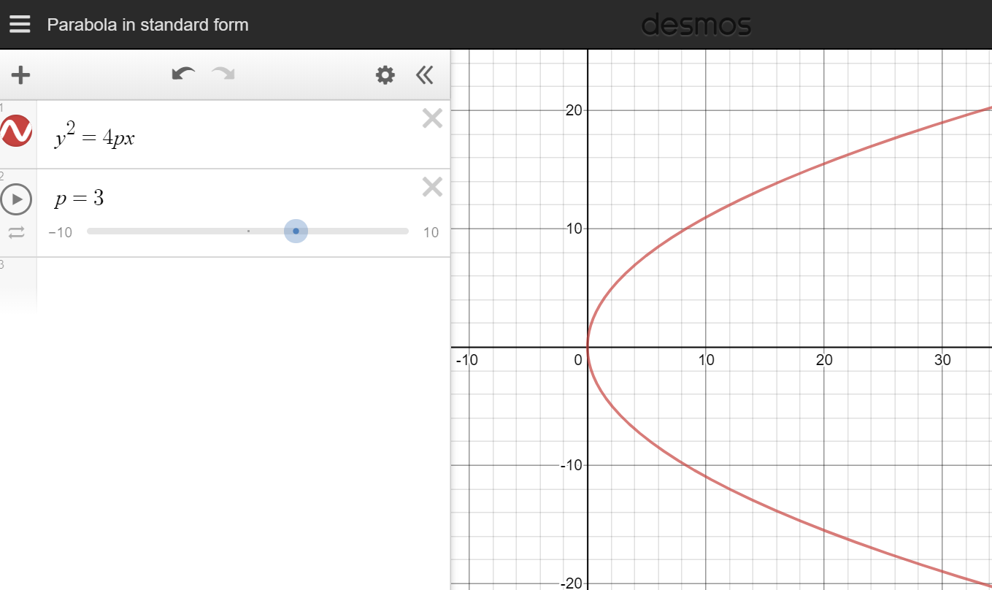
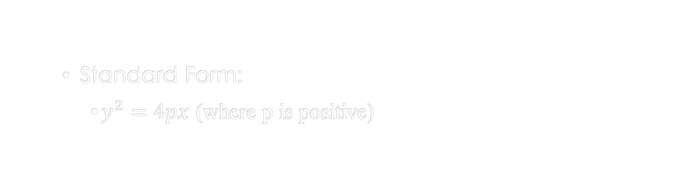
Parabola
Standard Form:
$y^{2}=4px$ (where p is positive)

Slide 11
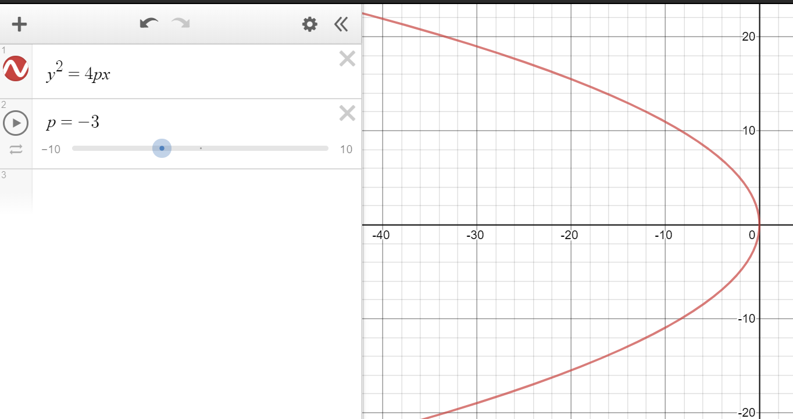
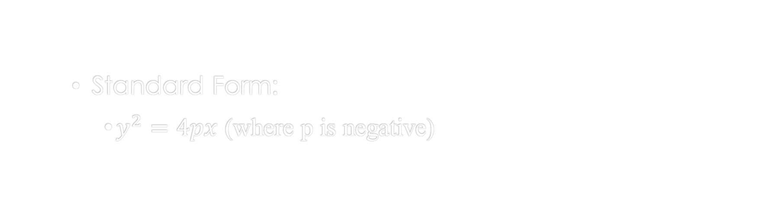
Parabola
Standard Form:
$y^{2}=4px$ (where p is negative)

Slide 12
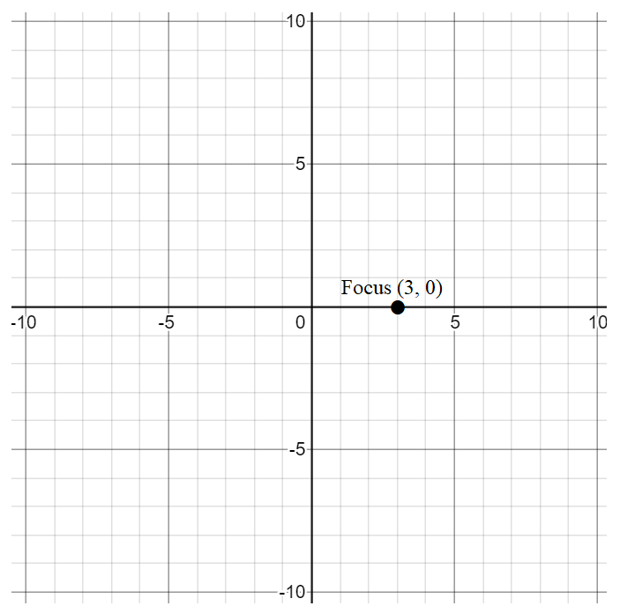
Parabola
Example 1: Find the equation of the parabola with focus at (3,0) and the directrix x = -3.
First plot the focus at (3,0)

Slide 13
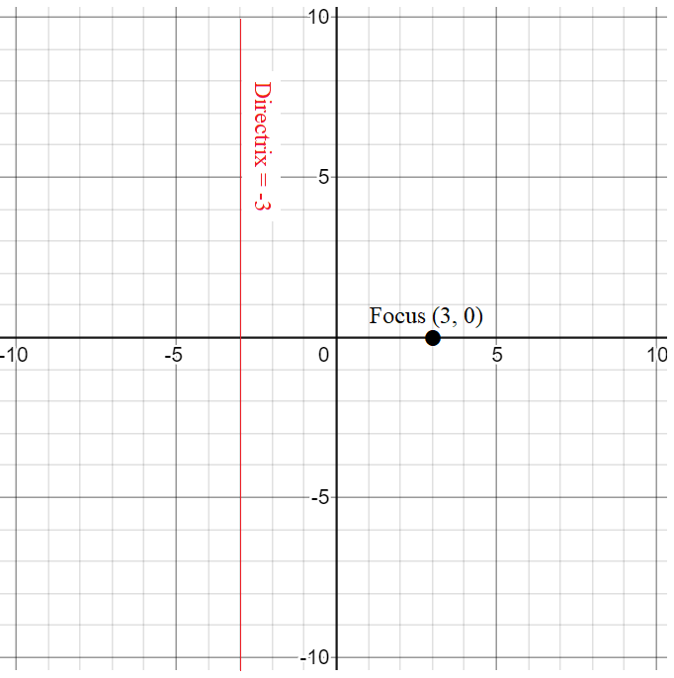
Parabola
Example 1: Find the equation of the parabola with focus at (3,0) and the directrix x = -3.
plot the focus at (3,0)
plot the directrix x = -3

Slide 14
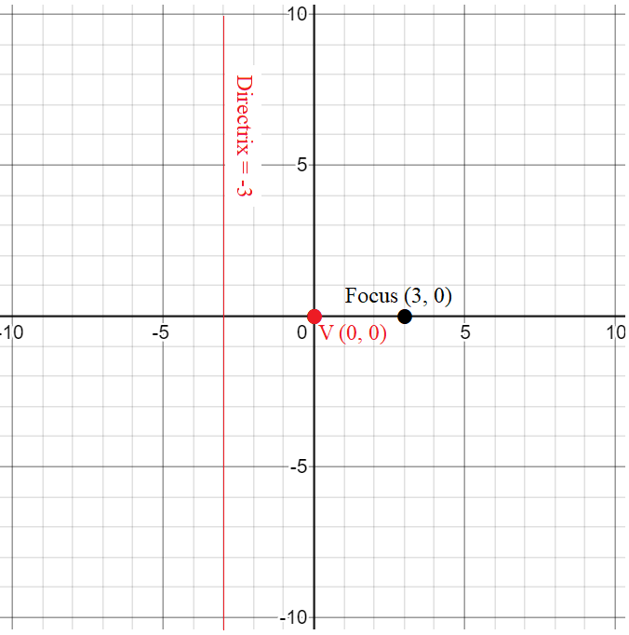
Parabola
Example 1: Find the equation of the parabola with focus at (3,0) and the directrix x = -3.
Plot the focus at (3,0)
Plot the directrix x = -3
Find the vertex,
We know the vertex is at the exact middle between directrix and focus
Find p in the standard equation
p is equal to the distance from the vertex to the focus.
In this case p is going positive on the x axis from 0 to 3, p = 3
We also know that this parabola is opening to the positive x axis, (to the right of the graph)

Slide 15
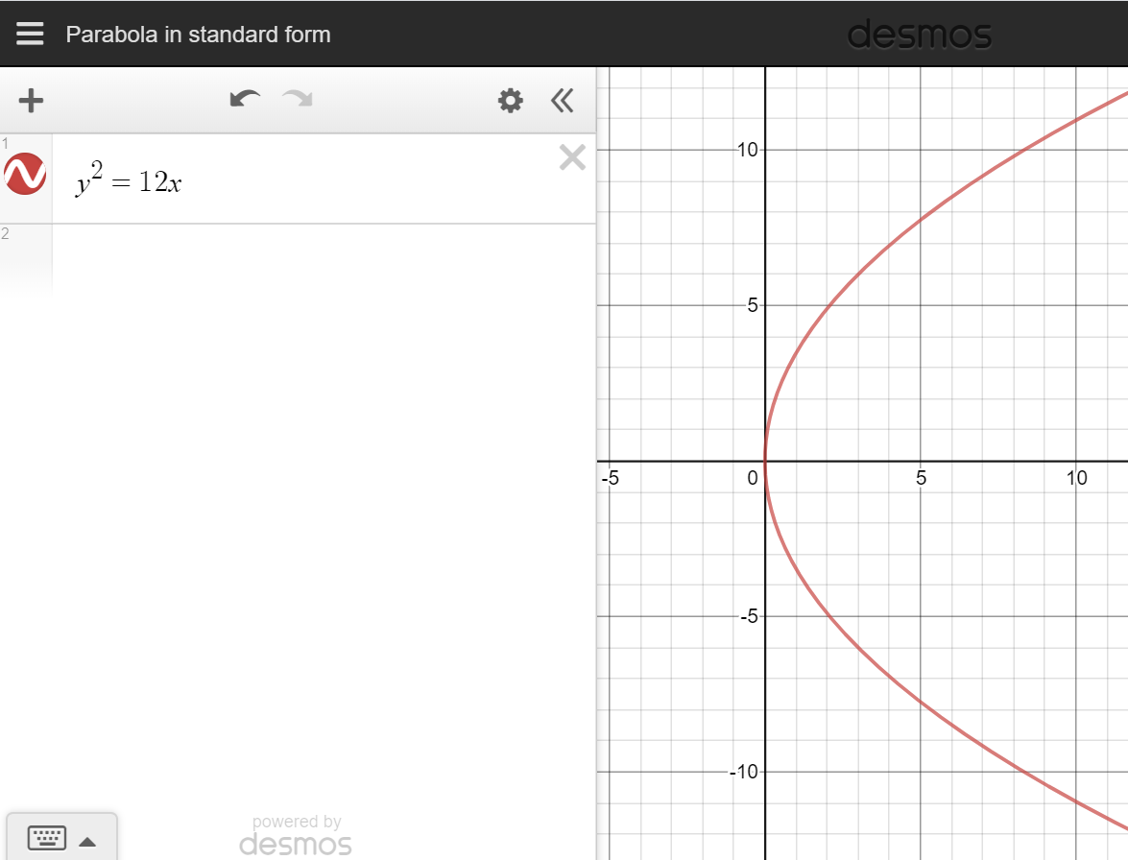

Parabola
Example 1: Find the equation of the parabola with focus at (3,0) and the directrix x = -3.
Standard form equation for an right opening parabola is:
$y^{2}=4px$
$y^{2}=4(3)x$
$y^{2}=12x$

Slide 16
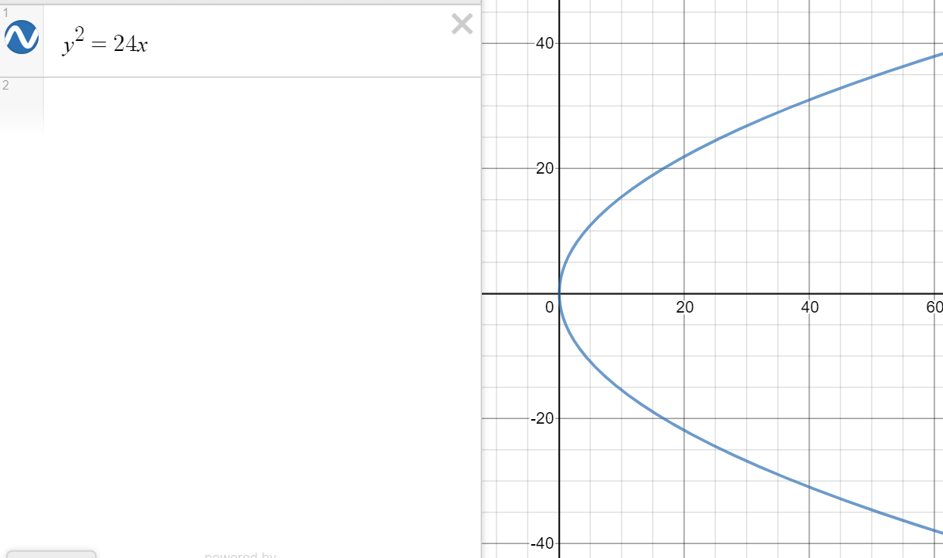
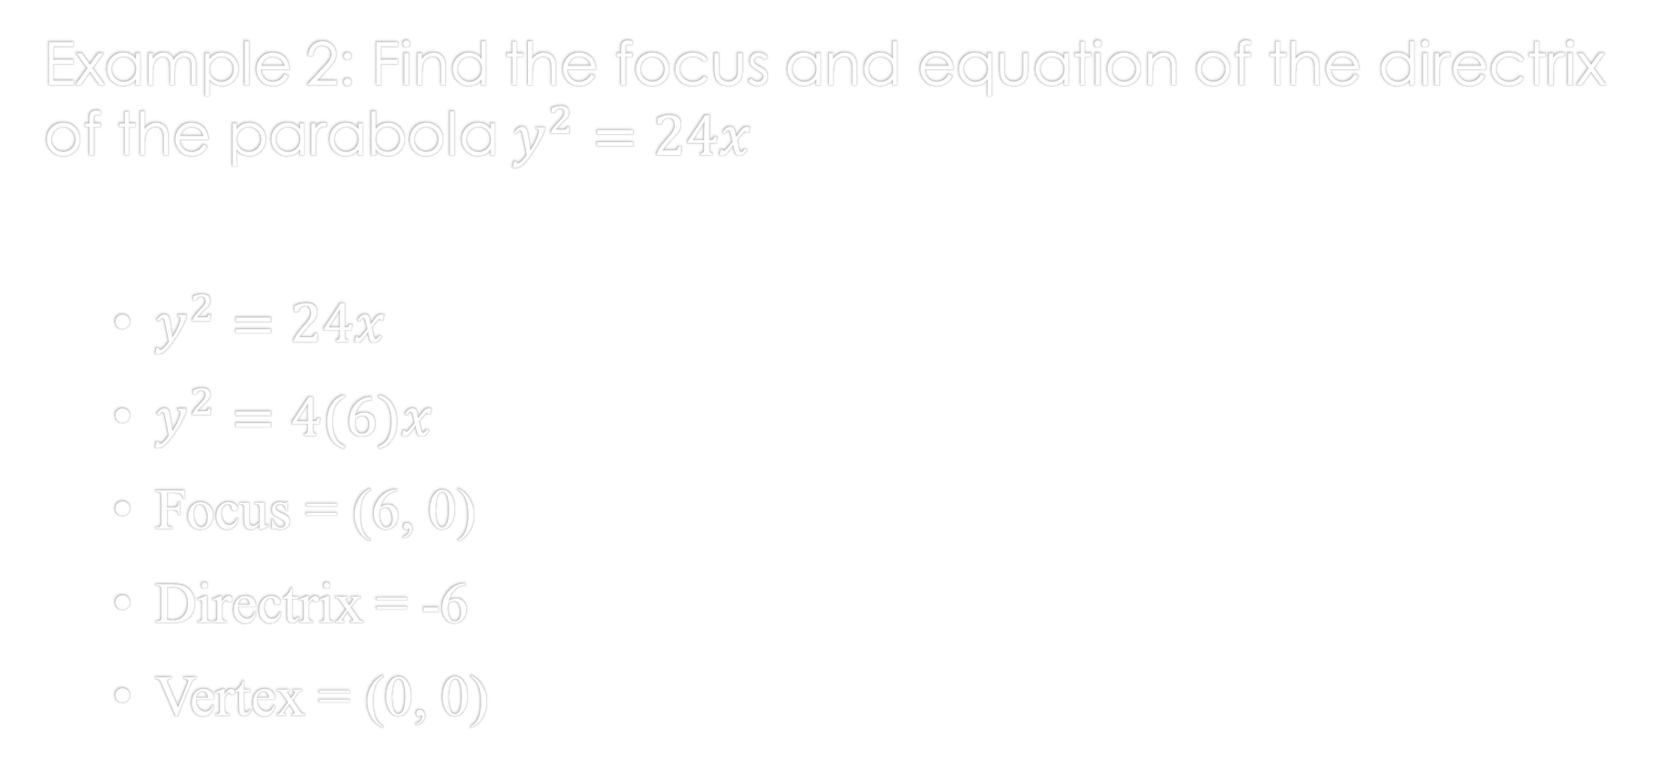
Parabola
Example 2: Find the focus and equation of the directrix of the parabola $y^{2}=24x$
$y^{2}=24x$
$y^{2}=4(6)x$
Focus = (6, 0)
Directrix = -6
Vertex = (0, 0)

Slide 17
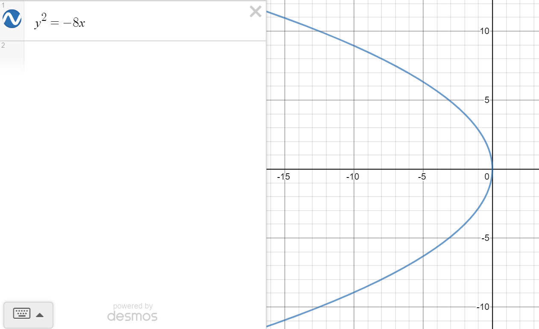
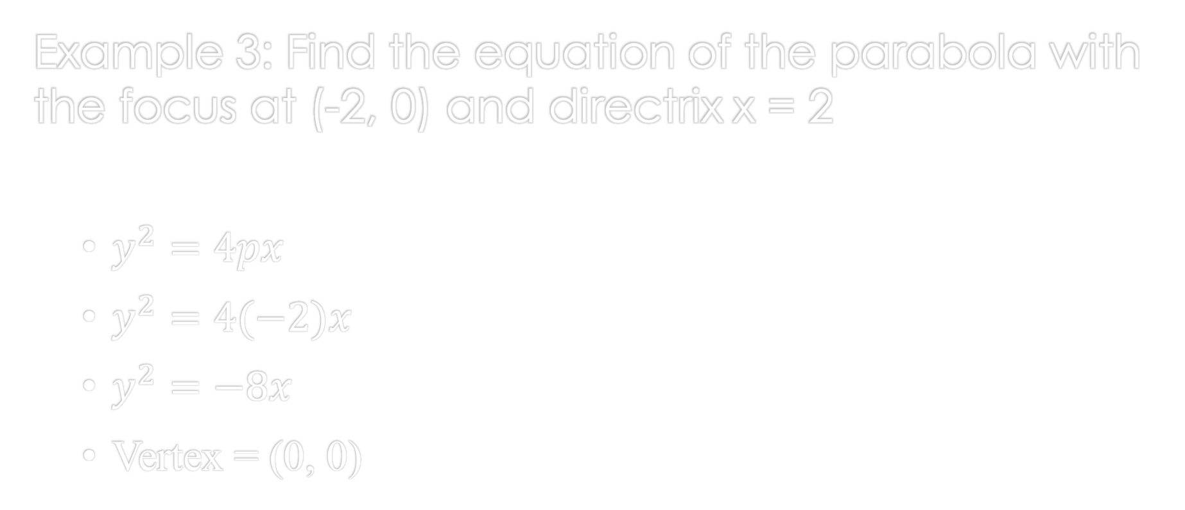
Parabola
Example 3: Find the equation of the parabola with the focus at (-2, 0) and directrix x = 2
$y^{2}=4px$
$y^{2}=4(−2)x$
$y^{2}=−8x$
Vertex = (0, 0)

Slide 18
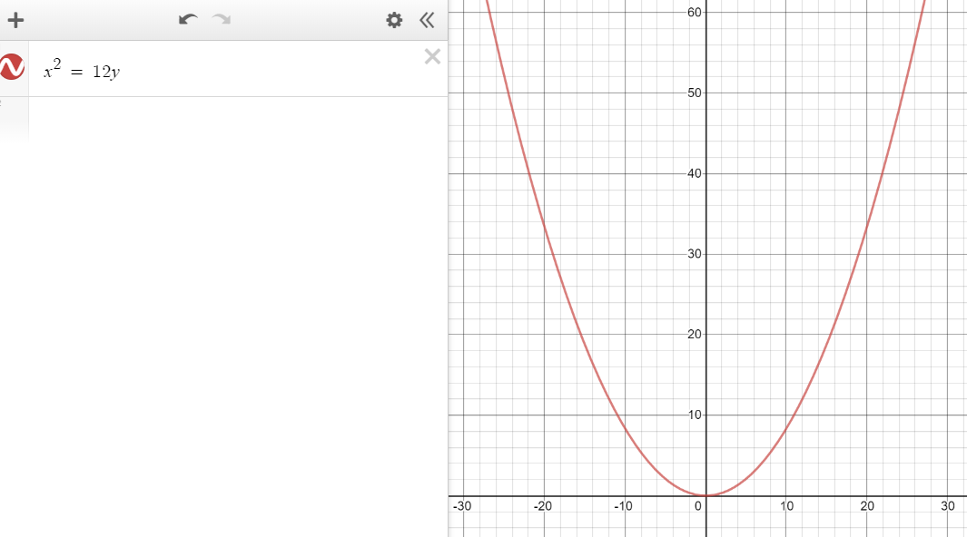
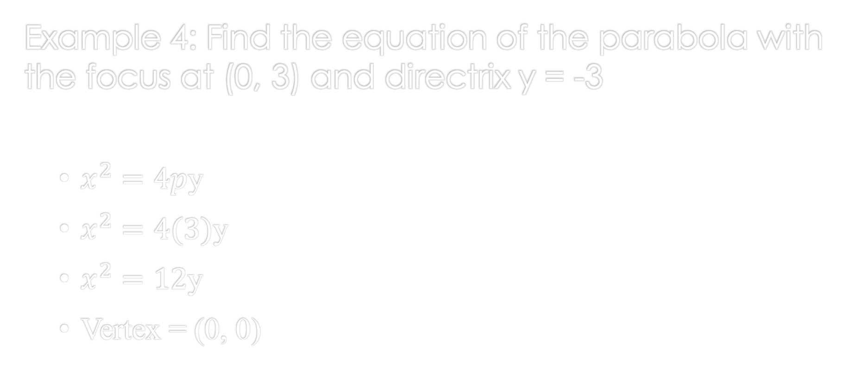
Parabola
Example 4: Find the equation of the parabola with the focus at (0, 3) and directrix y = -3
$x^{2}=4p$y
$x^{2}=4(3)$y
$x^{2}=12$y
Vertex = (0, 0)

Slide 19
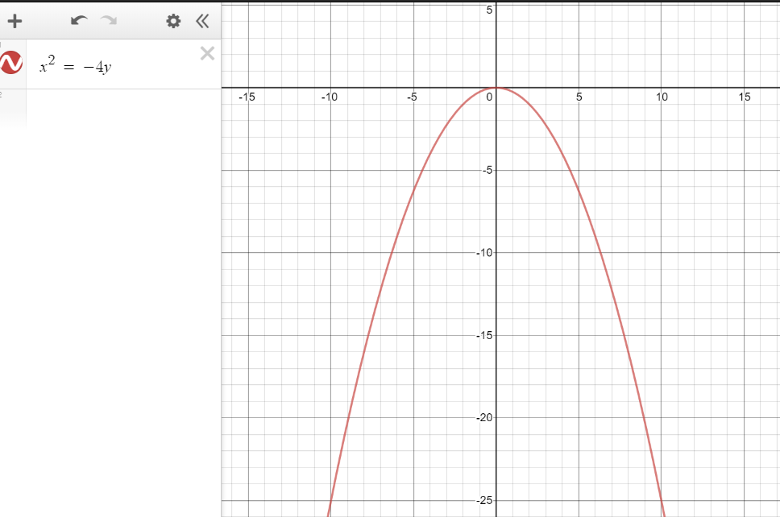
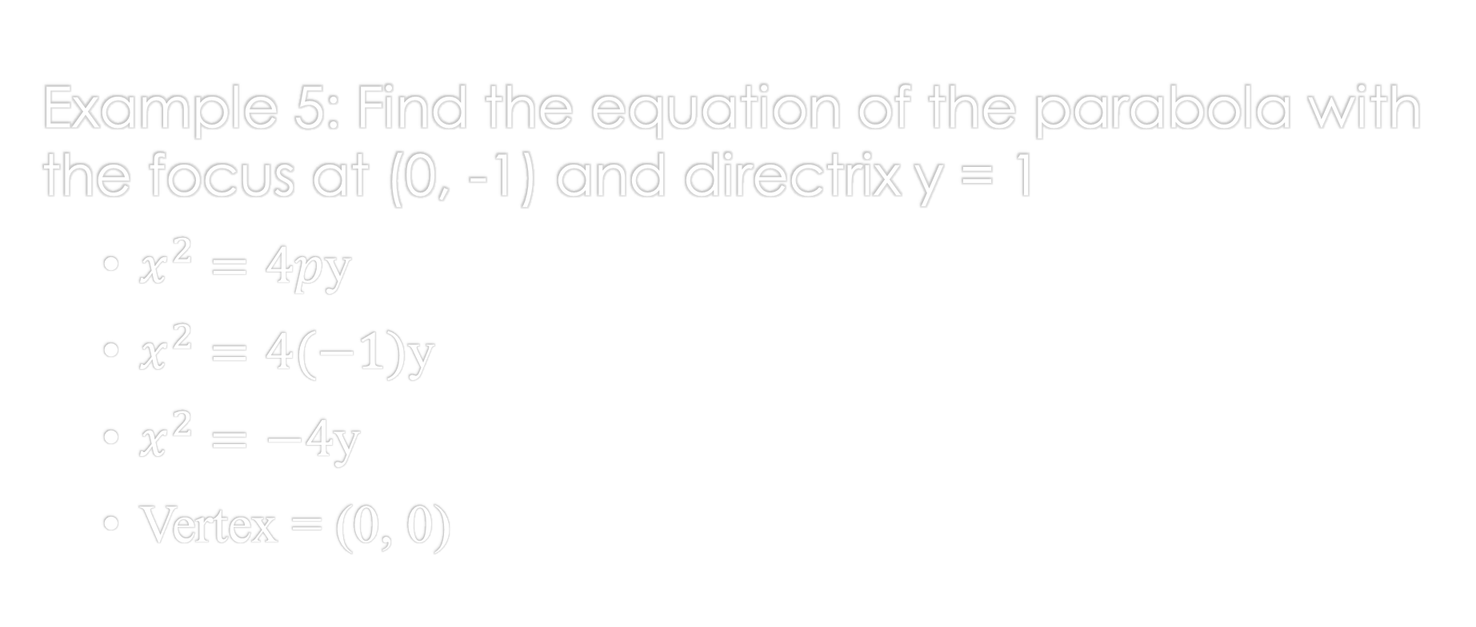
Parabola
Example 5: Find the equation of the parabola with the focus at (0, -1) and directrix y = 1
$x^{2}=4p$y
$x^{2}=4(−1)$y
$x^{2}=−4$y
Vertex = (0, 0)

Slide 20
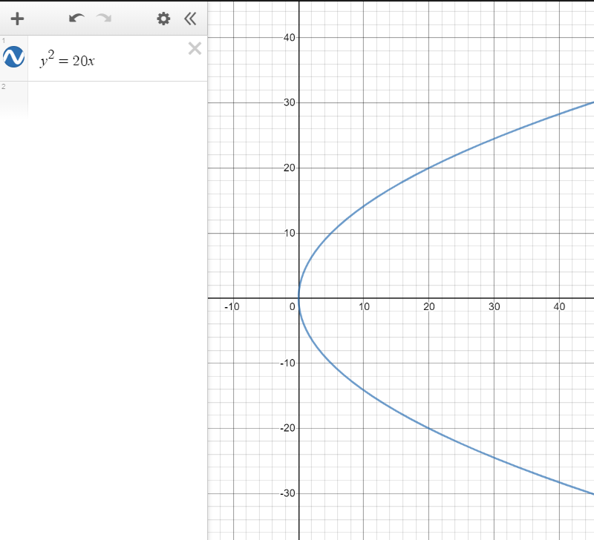
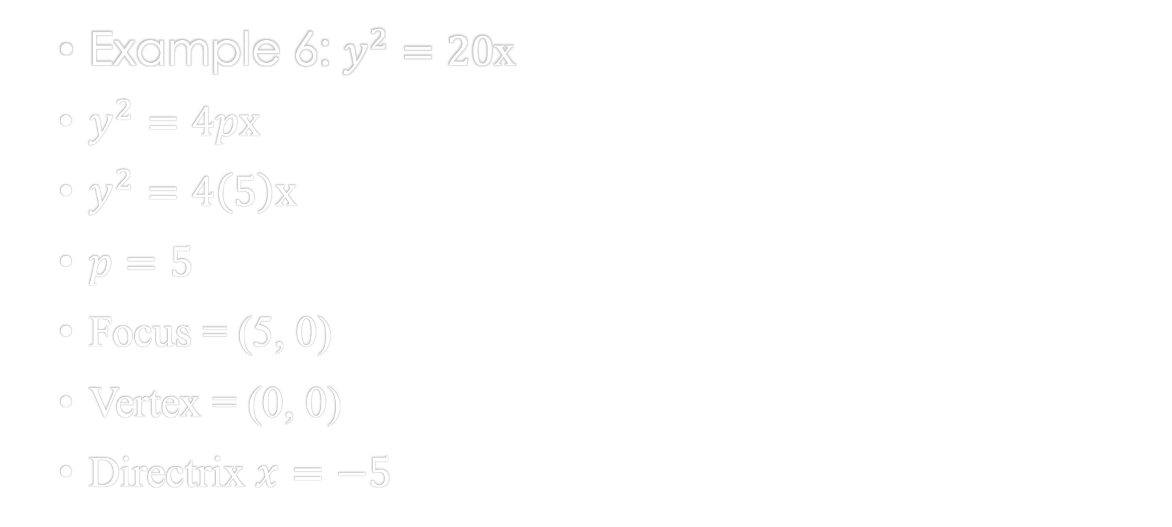
Parabola
Example 6: $y^{2}=20$x
$y^{2}=4px$
$y^{2}=4\left(5\right)x$
$p=5$
Focus = (5, 0)
Vertex = (0, 0)
Directrix $x=−5$

Slide 21
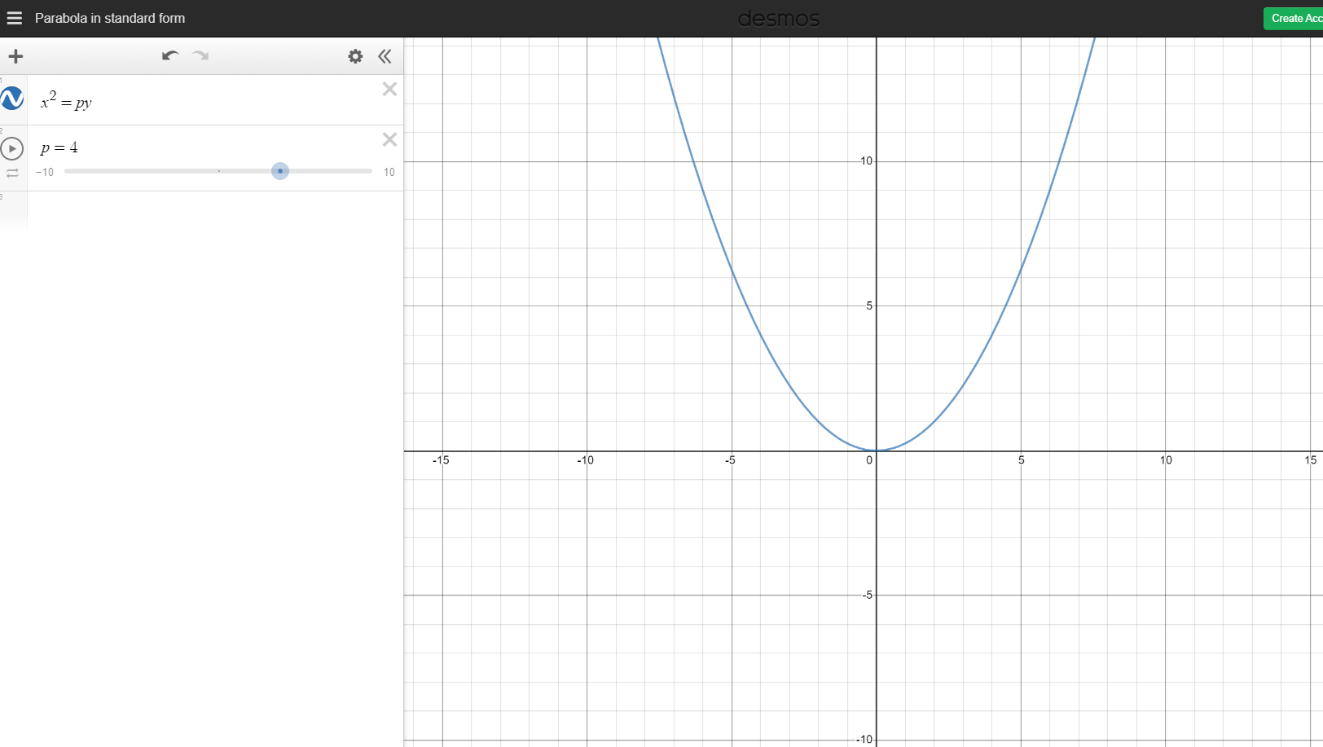
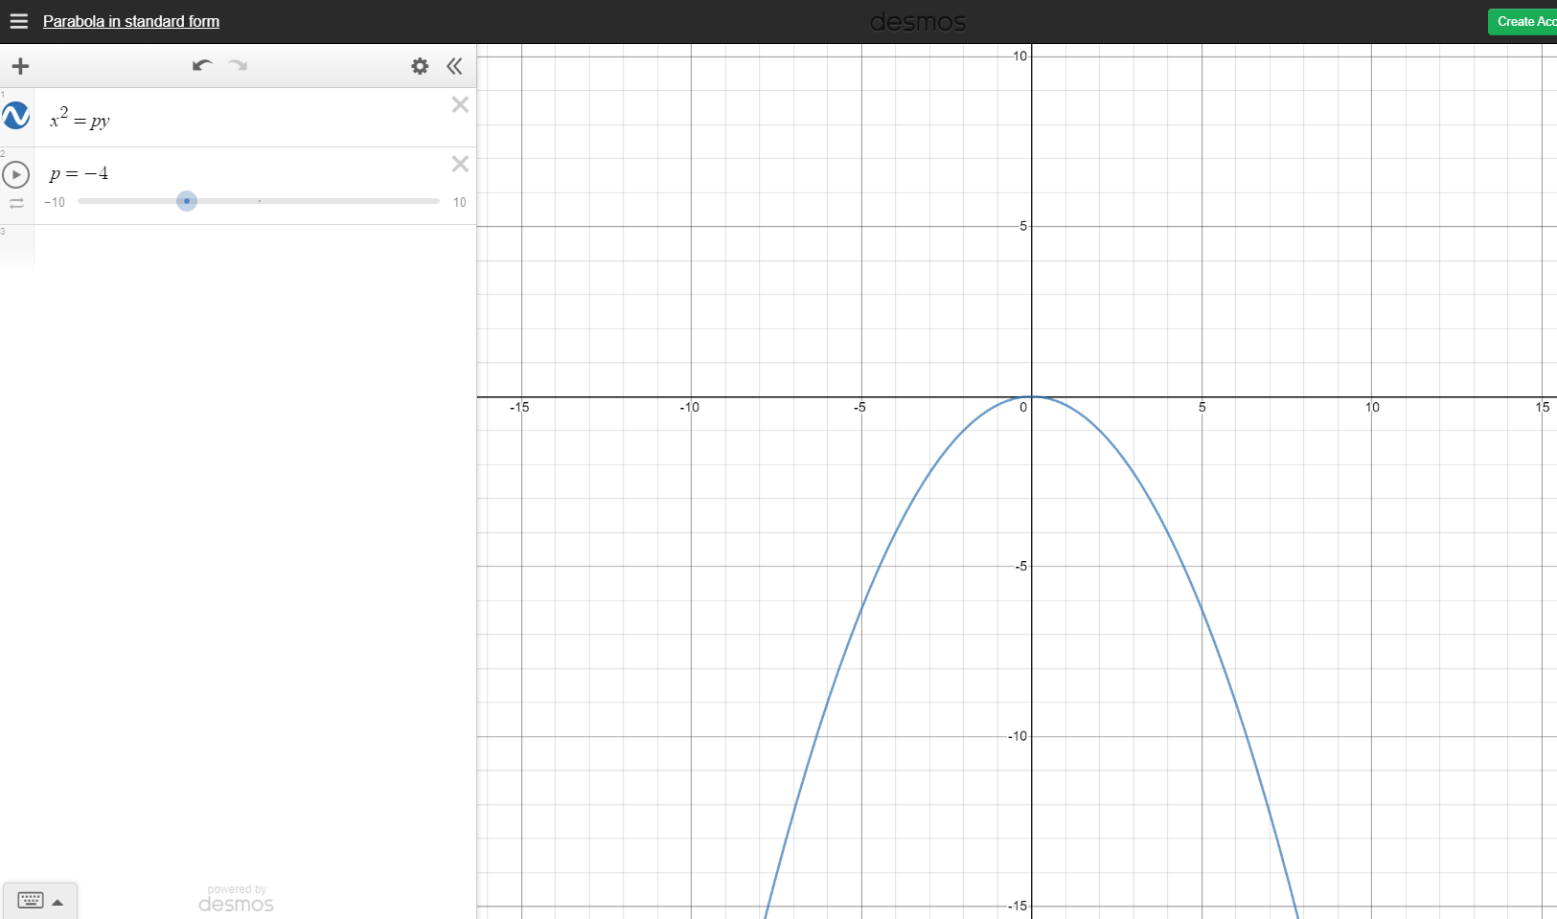
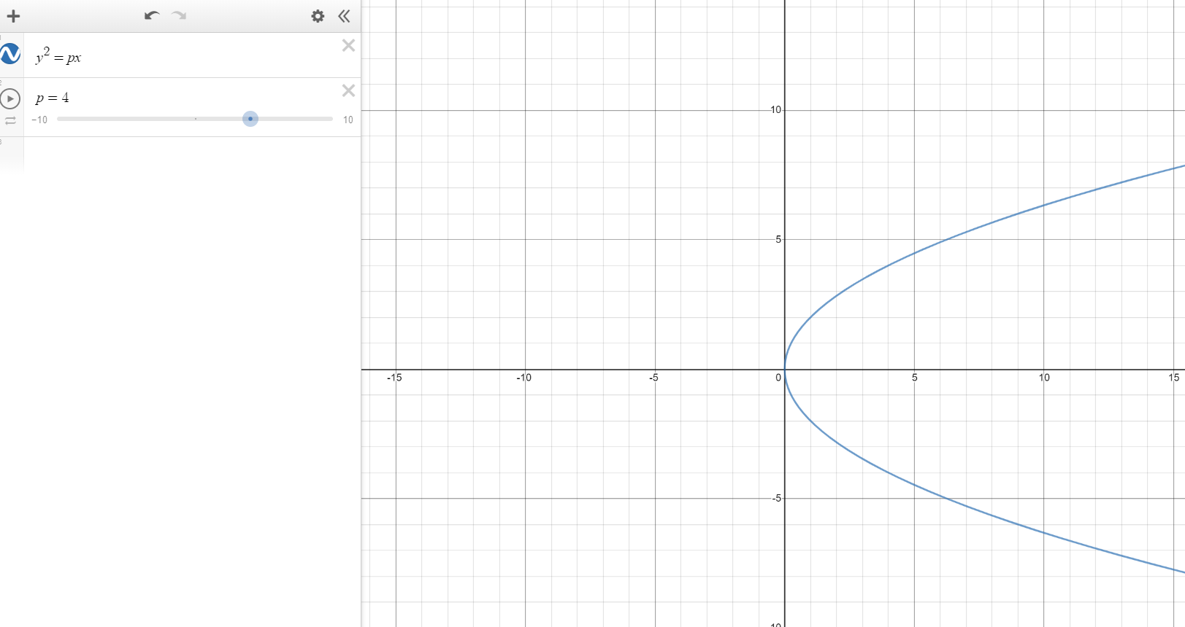
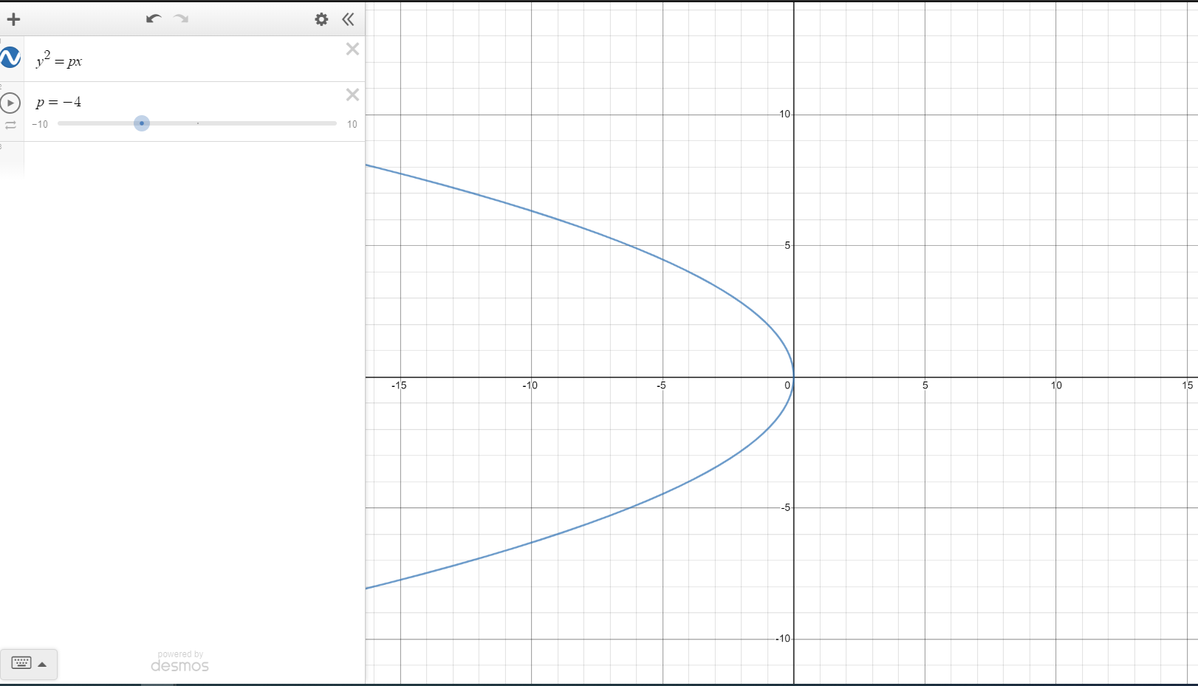
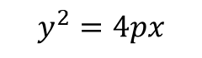
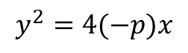
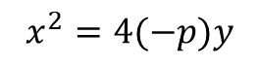
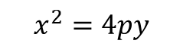
Parabola
$$x^{2}=4(−p)y$$
$$x^{2}=4py$$
$$y^{2}=4px$$
$$y^{2}=4(−p)x$$

Slide 22
Parabola
References:
Ewen, D., Gary, J. S., & Trefzger, J. E. (2005). Technical calculus. Upper Saddle River, NJ: Pearson/Prentice Hall.
https://www.desmos.com/calculator/zs5wfg9uem

